Slide 1
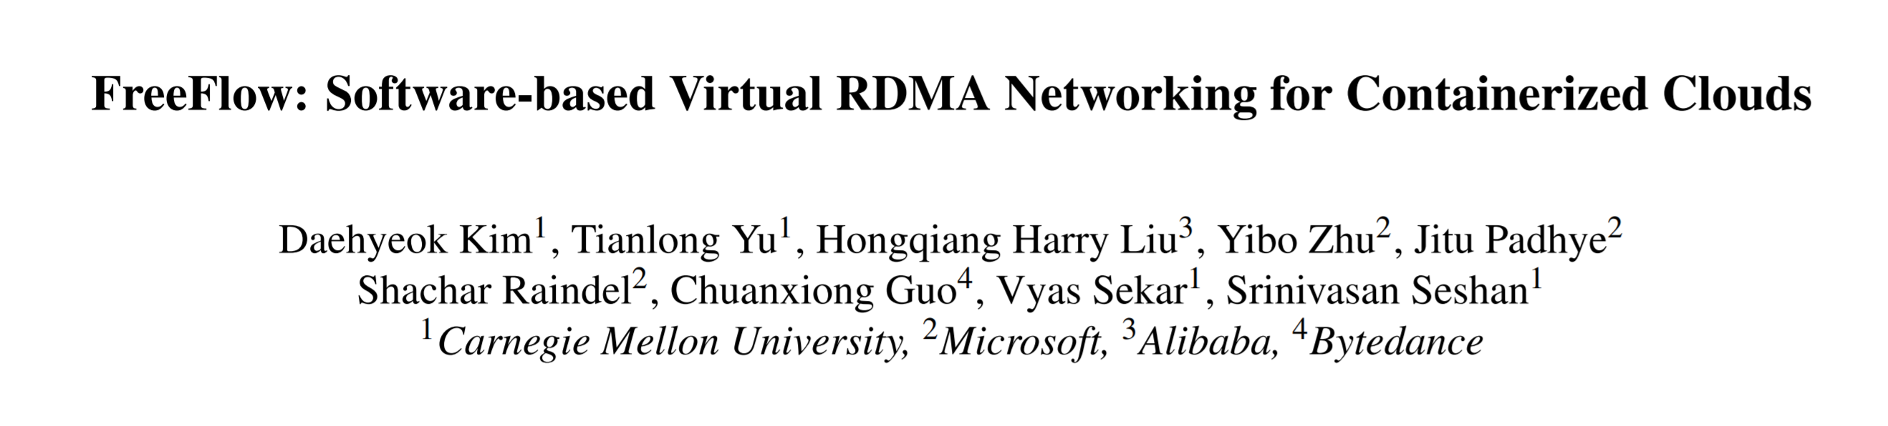
Talker: Jingrong Chen
2018/11/24
Notes:
一句话介绍 总结一下FreeFlow
Freeflow提供了一种纯软件的方式，实现了RDMA的虚拟化，从而使应用能够在享受RDMA高性能的同时，获得云环境带来的，如多租户隔离，可迁移性和可控制性(both control plane data plane)
这相当于使RDMA从原来的private cluster -> cloud 成为了可能

Slide 2
Agenda
Background
Overview
Overall Design
Implementation Details
Evaluation
Micro-benchmarks
Real world Applications
Related Work
Notes:
给大家讲的时候，还是基本按照paper的结构和顺序展开讲的
但我会把重心放在前面的部分，就是希望能把
这是一个什么东西
解决了什么问题
用的什么方法/思路解决的
这三个点和的大家讲清楚
因为文章最中间的4页多篇幅，是Freeflow实现的challenge和做法，这部分基本上来说，是用engineering的方法，解决了engineering的问题
我个人觉得问题本身和问题解决的过程不是特别的吸引人

Slide 3
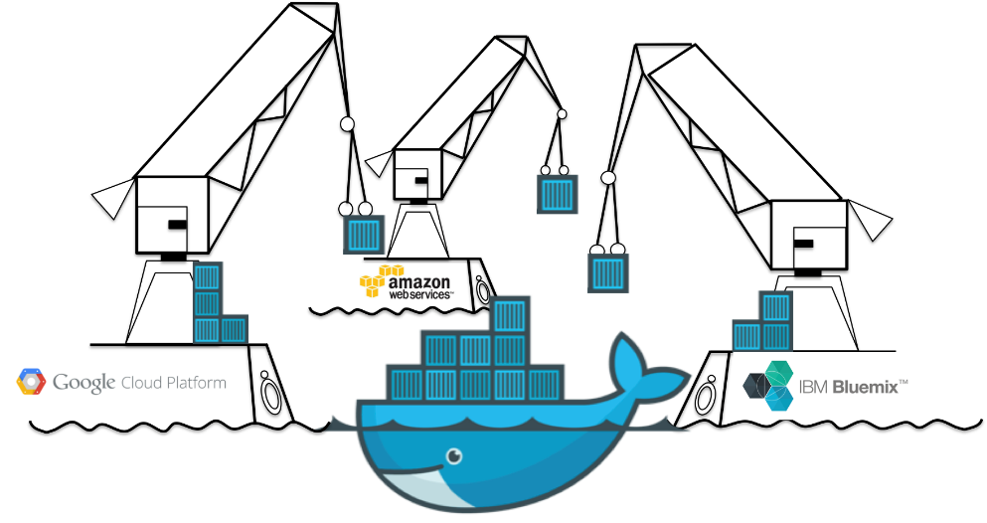
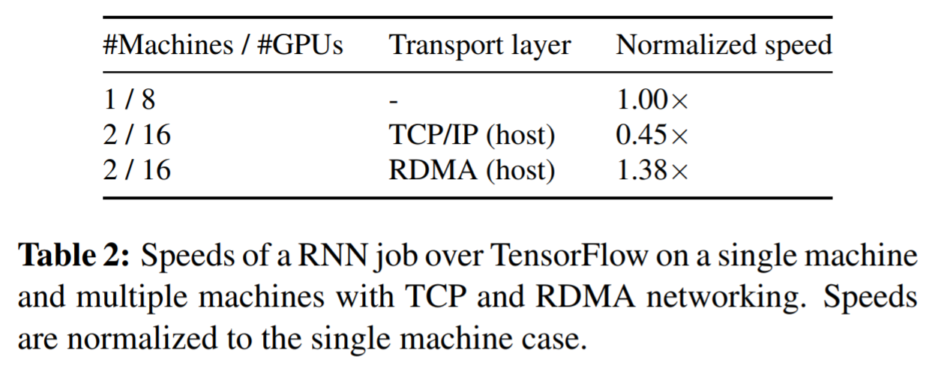
Background
Containers
RDMA networking
Significantly higher throughput
Lower latency
Lower CPU utilization
Notes:
这里写的比较口语化
介绍容器：
容器通过xxx方法，提供了数据中心或云环境下虚拟化的轻量级解决方案
容器技术作为一种轻量级虚拟化方案，极大的方便了应用程序打包，发布，部署的过程。
然后说GCP，azure等卖容器
在现在数据中心里，尤其是cloud环境下
可以说，容器已经成为打包部署应用程序的一个事实上的标准。
然后就举一个tensorflow + k8s的例子
Table 2这边，原因文章里解释是说，每次迭代会产生很多bursty的workloads，TCP在频繁的 bursty的情况下表现比较差，而RDMA能够立即以线速发送，所以表现会好

Slide 4
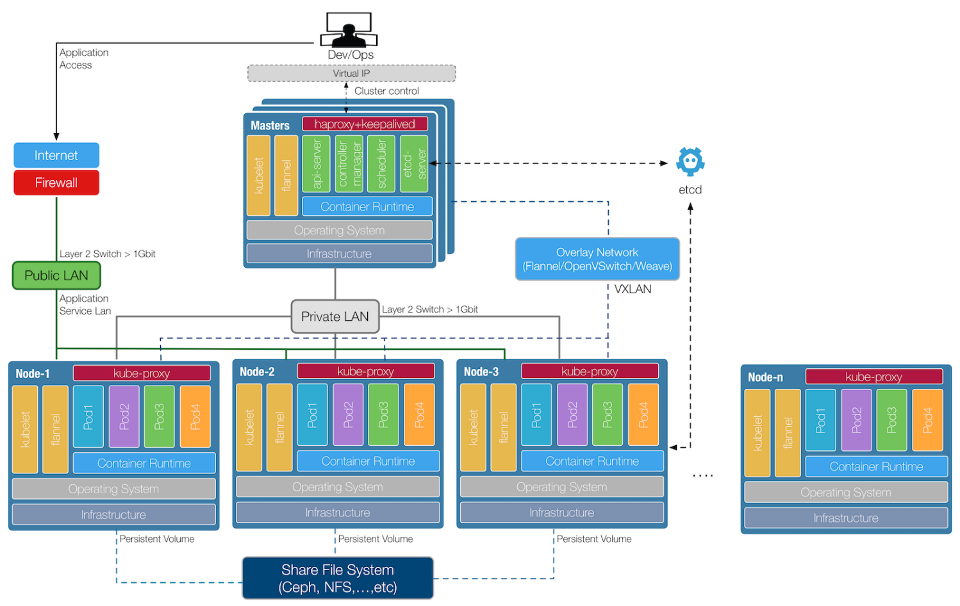
Background
Containers
RDMA networking
Significantly higher throughput
Lower latency
Lower CPU utilization
Notes:
这里写的比较口语化
介绍容器：
容器通过xxx方法，提供了数据中心或云环境下虚拟化的轻量级解决方案
容器技术作为一种轻量级虚拟化方案，极大的方便了应用程序打包，发布，部署的过程。
然后说GCP，azure等卖容器
在现在数据中心里，尤其是cloud环境下
可以说，容器已经成为打包部署应用程序的一个事实上的标准。
这里就举一个tensorflow + k8s的例子
Table 2这边，原因文章里解释是说，每次迭代会产生很多bursty的workloads，TCP在频繁的 bursty的情况下表现比较差，而RDMA能够立即以线速发送，所以表现会好

Slide 5
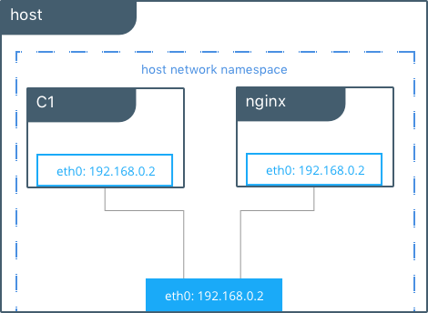
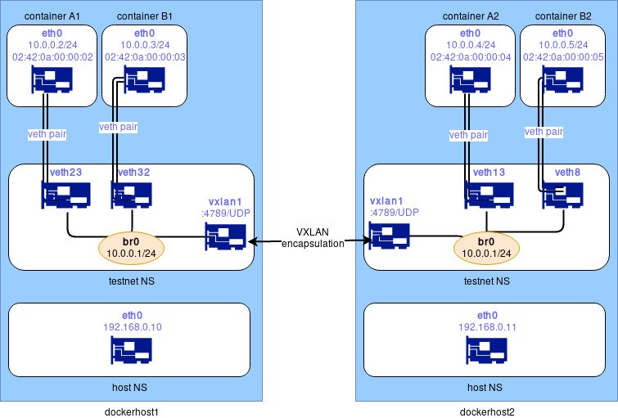
Container networking
Host mode
Shared network namespace
Use host’s IP and port
Poor isolation and portability
Virtual mode (bridge / overlay)
Isolated network namespace
Portability
Controllability both on control plane and data plane

Slide 6
Background
Container -> lower management cost + higher resource efficiency
RDMA -> better performance
Can we achieve these advantages at the same time?
Notes:
为什么直接不行呢

Slide 7
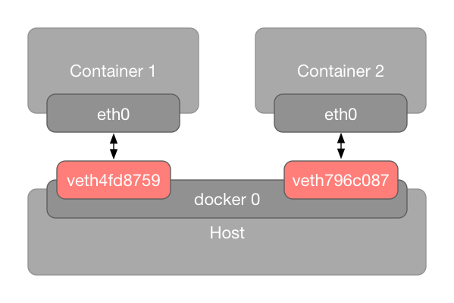
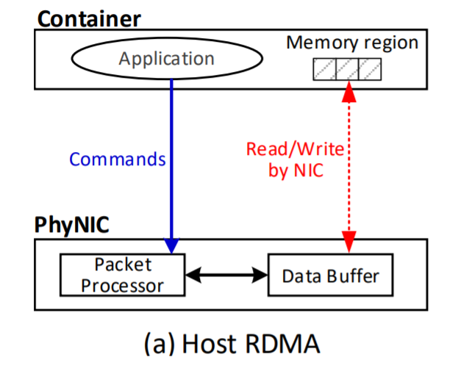
Background
Container -> lower management cost + higher resource efficiency
RDMA -> better performance
Can we achieve these advantages at the same time?
Run application in container with host mode to use RDMA?
Notes:
为什么直接不行呢

Slide 8
Background
3 properties that containerized cloud need in networking
Isolation – dedicated network namespace
Portability – be able to migrate to other host
Controllability – both on control plane(routing, ACL) and data plane(QoS, e.g. rate limit and metering)
Notes:
Metering is very helpful for performance analysis

Slide 9
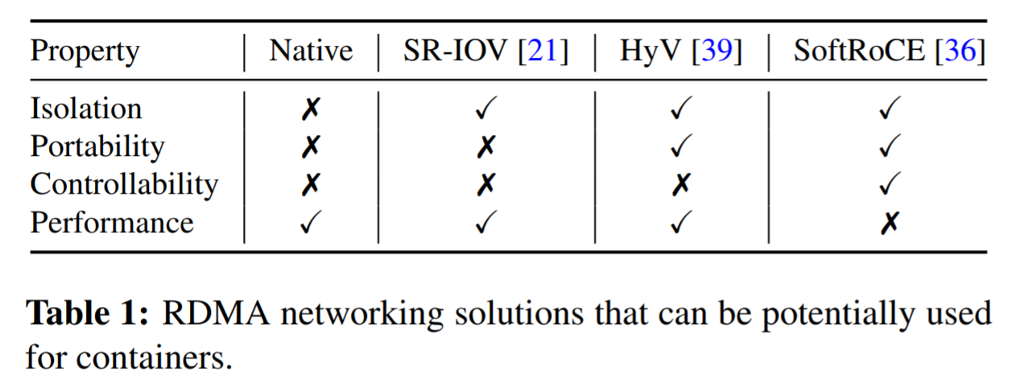
Background
Do we have other choices?
Isolation – dedicated network namespace
Portability – be able to migrate to other host
Controllability – both on control plane(routing, ACL) and data plane(QoS, e.g. rate limit and metering)
Notes:
Metering is very helpful for performance analysis

Slide 10
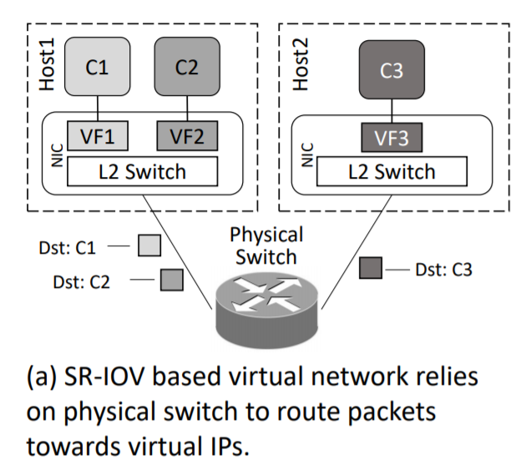
Background
Do we have other choices?
Isolation – dedicated network namespace
Portability – be able to migrate to other host
Controllability – both on control plane(routing, ACL) and data plane(QoS, e.g. rate limit and metering)
Notes:
Metering is very helpful for performance analysis

Slide 11
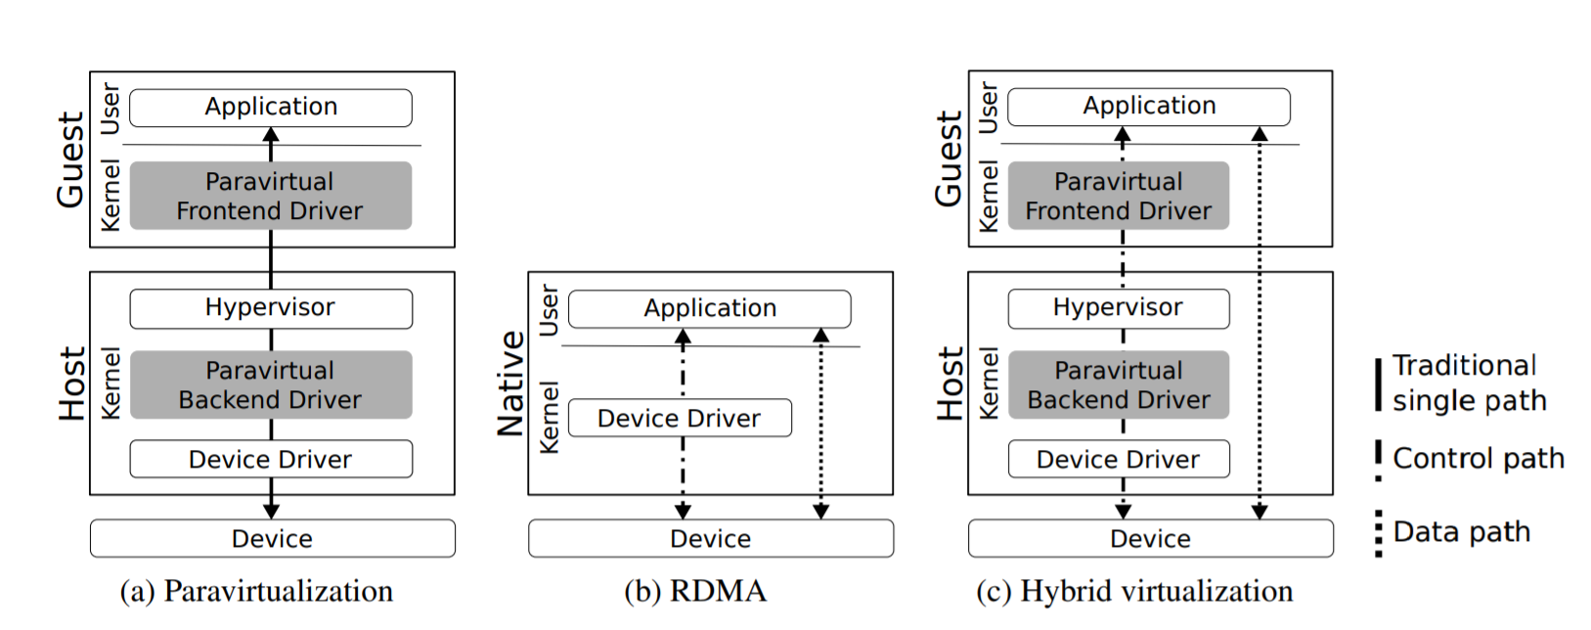
Background
Do we have other choices?
Isolation – dedicated network namespace
Portability – be able to migrate to other host
Controllability – both on control plane(routing, ACL) and data plane(QoS, e.g. rate limit and metering)
Notes:
Metering is very helpful for performance analysis

Slide 12
Agenda
Background
Overview
Overall Design
Implementation Details
Evaluation
Micro-benchmarks
Real world Applications
Related Work
Notes:
接下来讲freeflow到底做了什么事情了

Slide 13
FreeFlow Overview
Design goal
App can use RDMA in container
Transparent to application
Throughput and latency comparable to bare-metal RDMA
3 properties: isolation, portability, controllability
How?

Slide 14
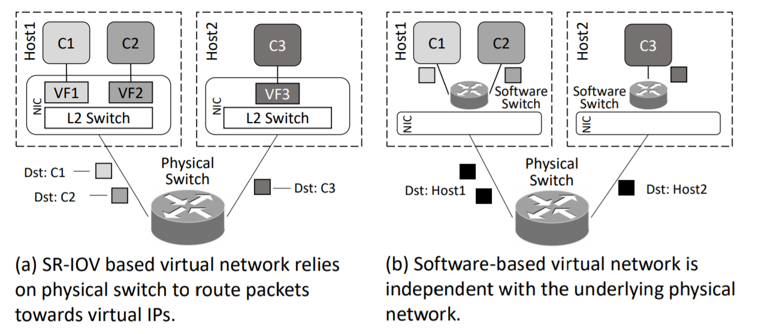
FreeFlow Overview
Design goal
Transparent to application
Throughput and latency comparable to bare-metal RDMA
3 properties: isolation, portability, controllability

Slide 15
FreeFlow Overall Design
How to implement the software switch for RDMA?
Packet level switch like OvS?
Notes:
How to implement the software swtich?
Do we need to intercepts the lowest level command between driver and NIC?
Or called, where do we perform the interception.

Slide 16
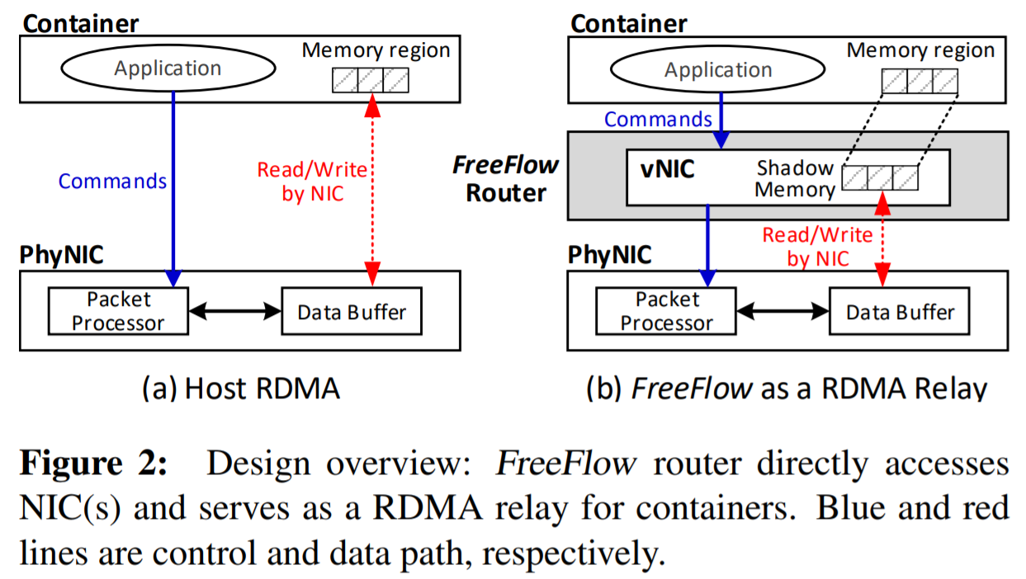
FreeFlow Overall Design
How to implement the software switch for RDMA?
Packet level switch like OvS?
Intercept communication between applications and RNIC
Notes:
How to implement the software swtich?
Do we need to intercepts the lowest level command between driver and NIC?
Or called, where do we perform the interception.

Slide 17
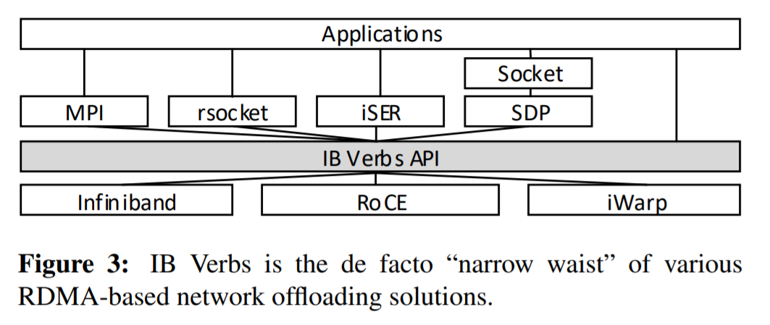
Where to perform the interception.
Verbs: the “narrow waist” for RDMA
Notes:
How to implement the software swtich?
Do we need to intercepts the lowest level command between driver and NIC?
Or called, where do we perform the interception.

Slide 18
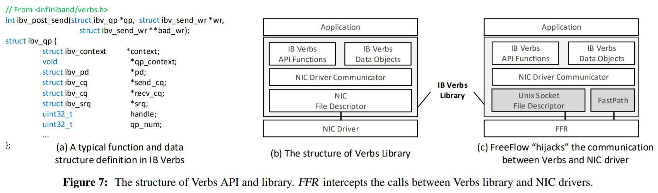
Where to perform the interception.
Verbs: the “narrow waist” for RDMA

Slide 19
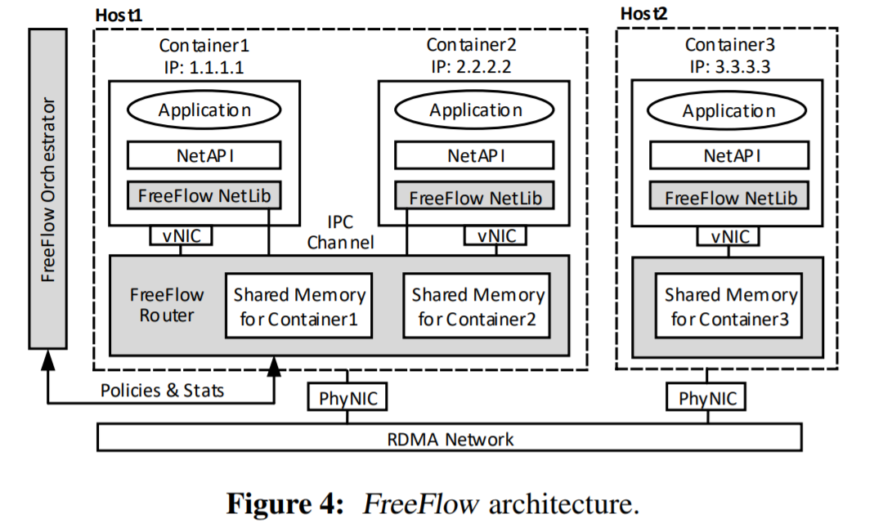
FreeFlow Architecture
FreeFlow network library (FFL), make FreeFlow transparent to app, coordinates with FFR
FreeFlow software router (FFR), single instance each host, memory mapping and request rely
FreeFlow network orchestrator (FFO), maintains memory mapping, control plane decisions
Notes:
FFL located inside the container, is the key to making FreeFlow transparent to applications. From application’s perspective, it is indistinguishable from the standard RDMA Verbs library [16]. All applications and middleware built atop the Verbs API can run with no (or negligible) modification. FFL coordinates with FFR.
FFR runs a single instance on each host and works with all containers on the same host to provide virtual networking. In the data plane, FFR shares memory buffers with containers on the same host and isolates the shared memory buffers for different containers. FFR sends and receives data in the shared memory through the NIC, relying on FFL to sync data between application’s private data buffers and the shared memory buffers. FFR implements the data-plane resource policies, e.g., QoS, by controlling the shared-memory channel between containers and FFR. It also works with FFO to handle bookkeeping tasks such as IP address assignment.
FFO makes control-plane decisions for all containers in its cluster based on user-defined configurations and real-time monitoring of the cluster

Slide 20
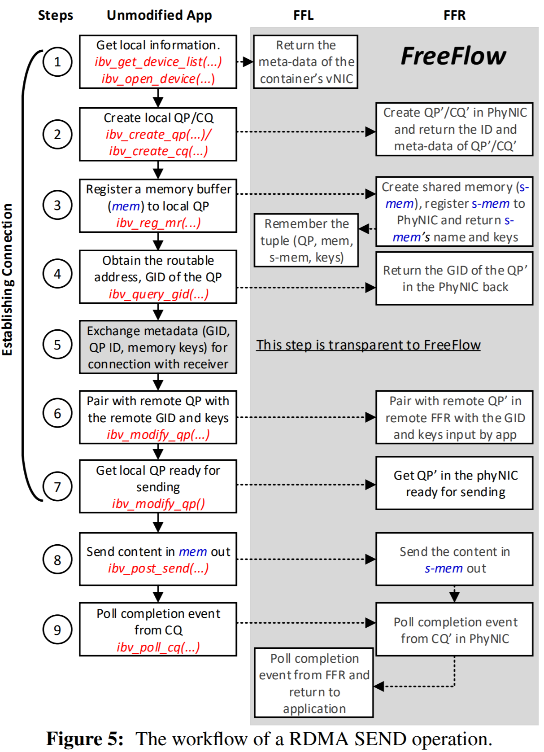
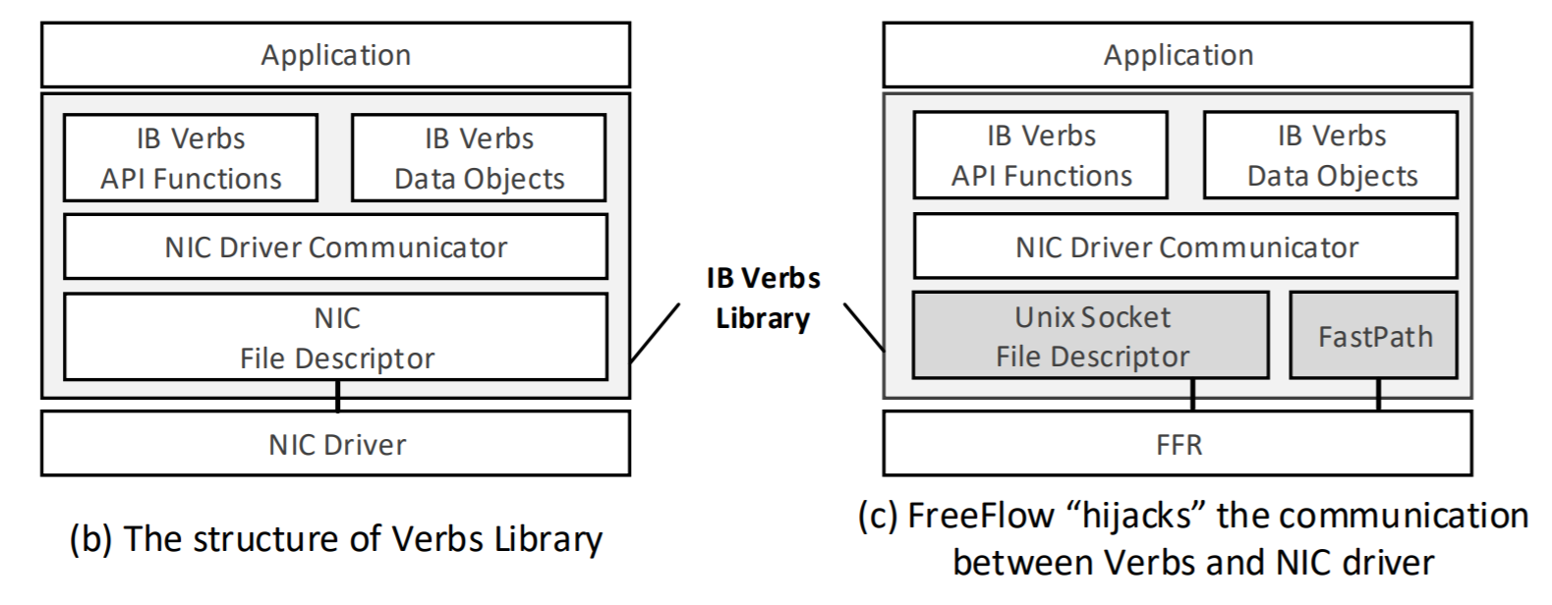
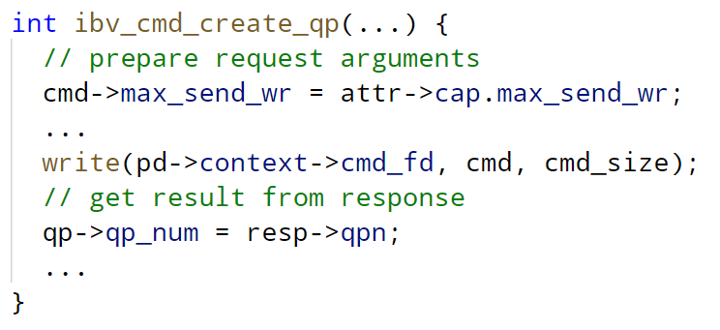
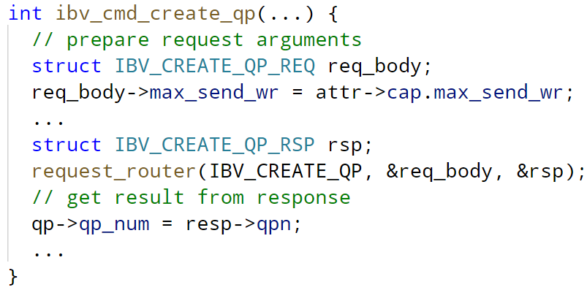
Details – transparent support for RDMA operations

Slide 21
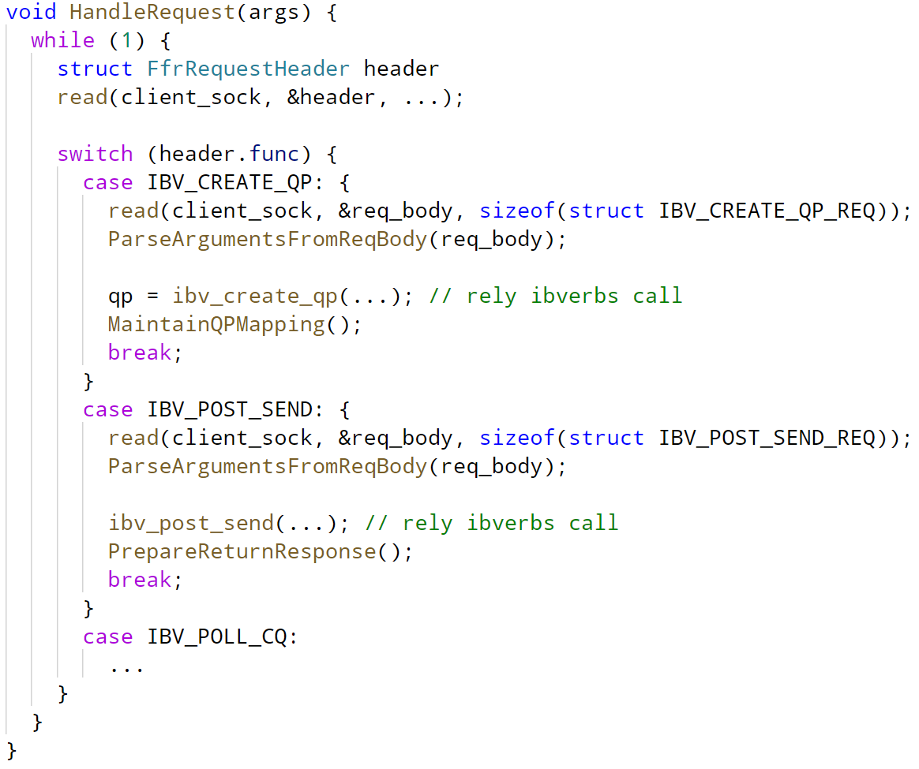
Details – transparent support for RDMA operations
FFR
FFL

Slide 22
Some discussions
FreeFlow can
Support control & data plan policies, e.g. per-flow rate limit, flow prioritization
Working with external legacy peers
Offline container migration
Run container in VM (with SR-IOV)

Slide 23
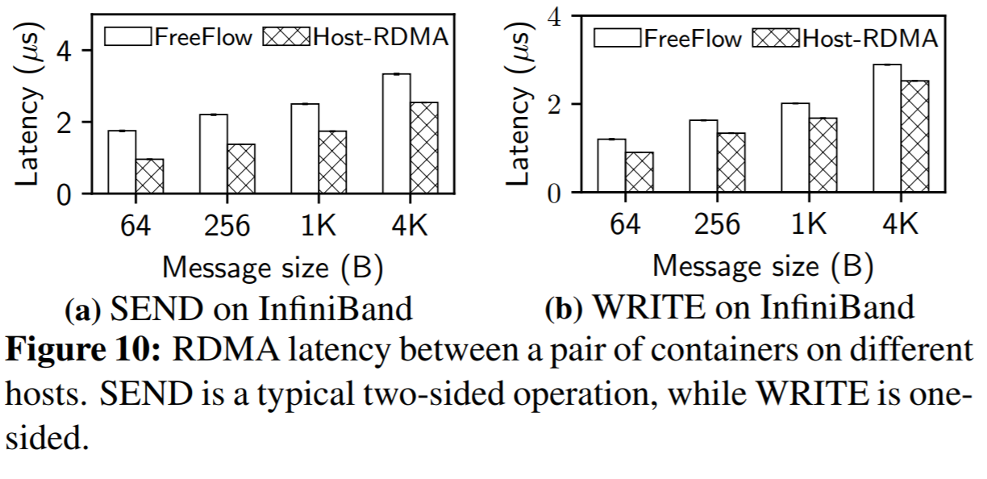
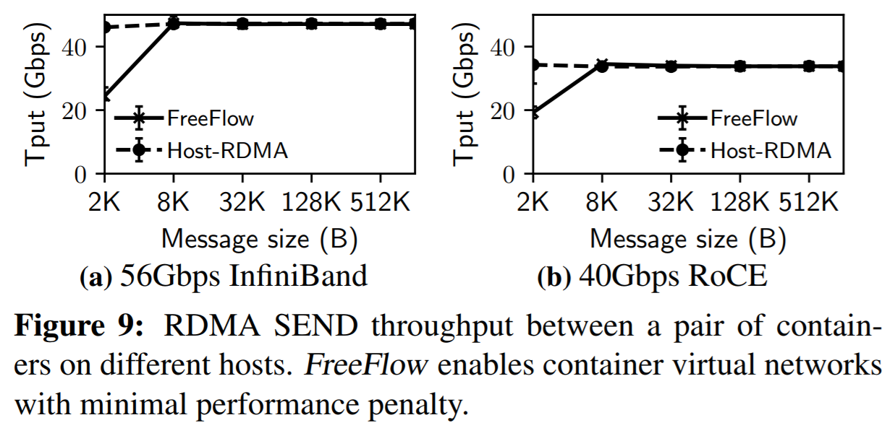
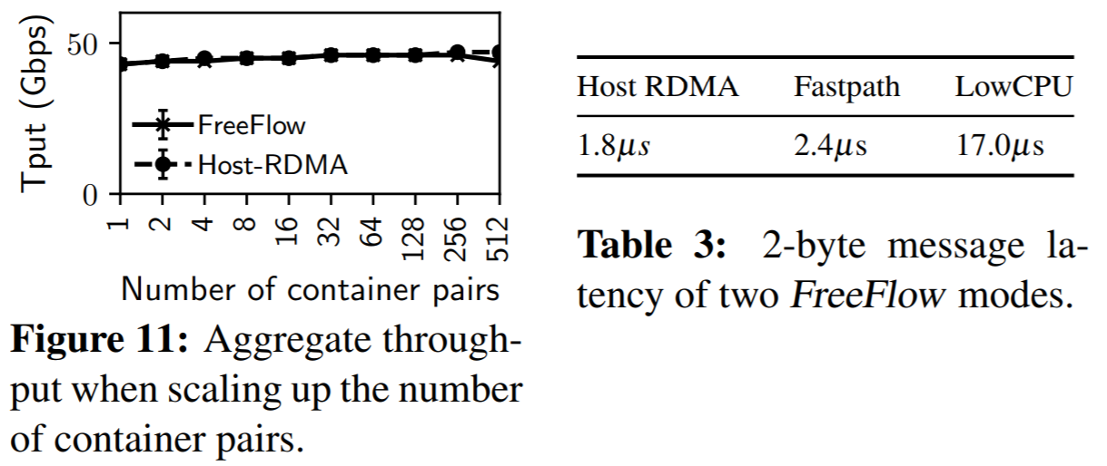
Evaluation
Micro-benchmark

Slide 24
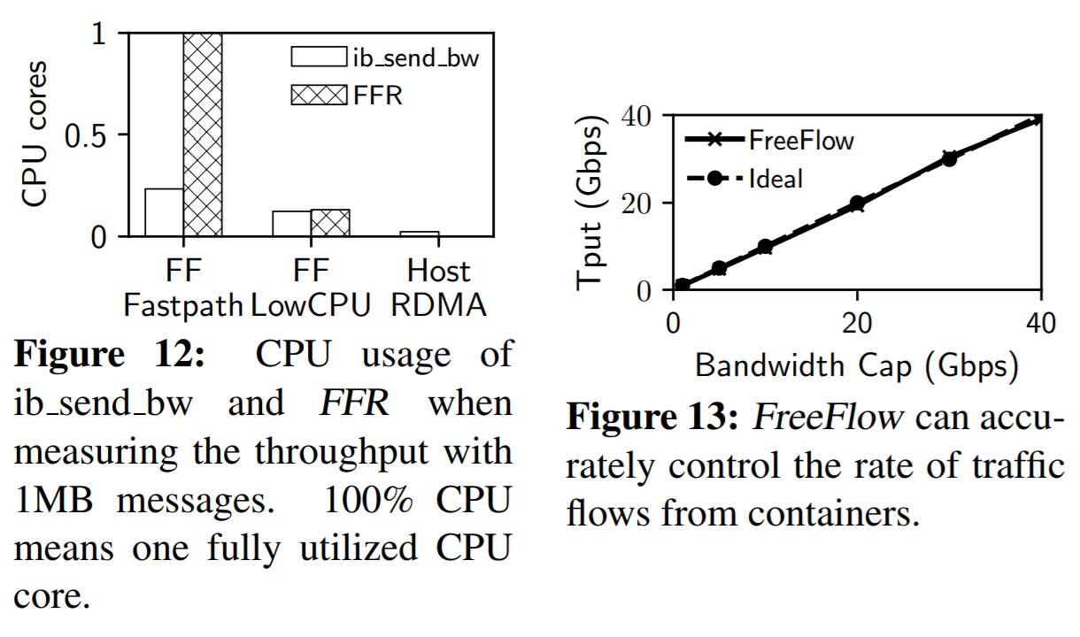
Evaluation
Micro-benchmark

Slide 25
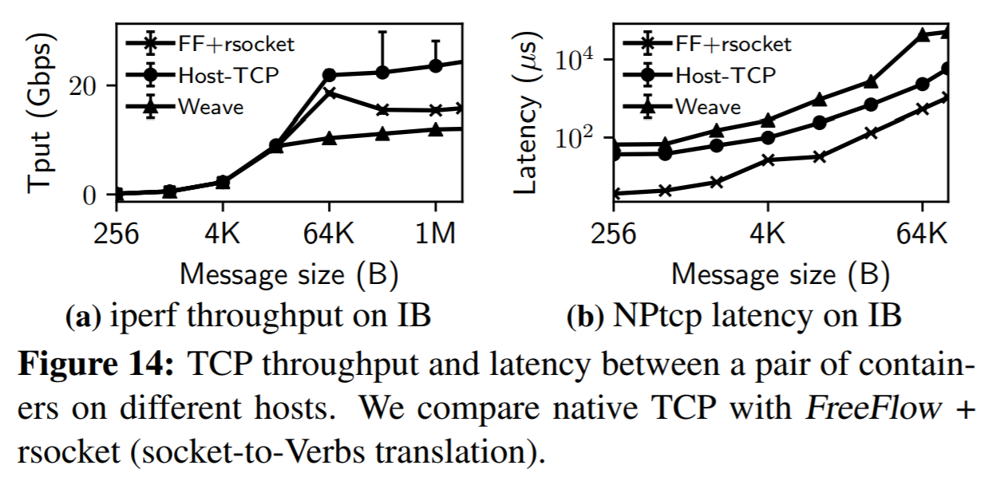
Evaluation
Micro-benchmark

Slide 26
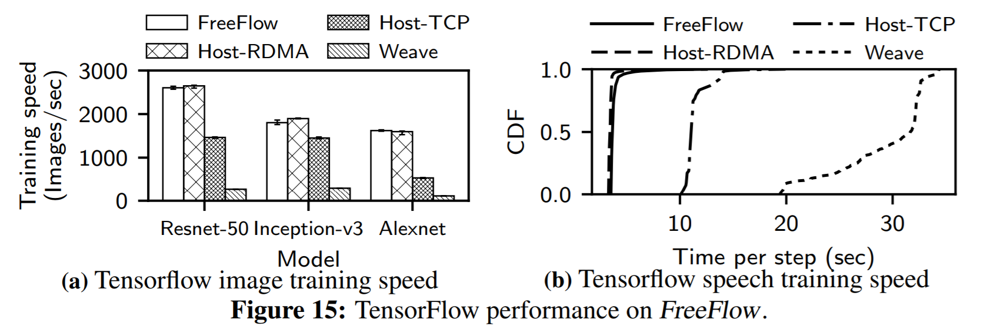
Evaluation
Real-world applications

Slide 27
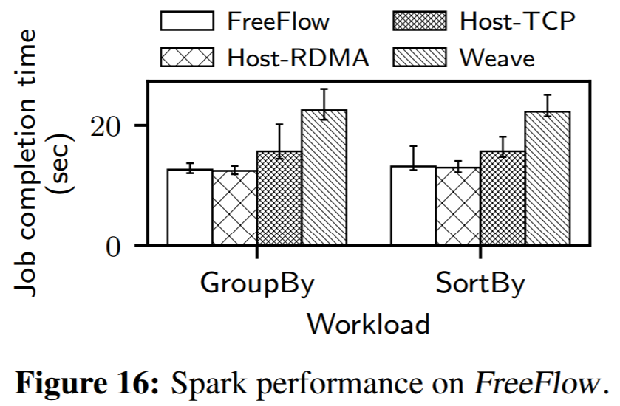
Evaluation
Real-world applications

Slide 28
Related Work
RDMA virtualization for containers: Mellanox, portability issue
Using programming hardware: software is more flexible than hardware
HyV: virtualization for VM, similar to FreeFlow but without data path control, not for container
Notes:
2

Slide 29
Summary
Containerization and RDMA are two inevitable trend in data center
FreeFlow use software method to combine the two technologies, achieved Isolation, Portability, Controllability and performance
I think the controllability is useful for instrumenting RDMA, container scheduling and QoS.
Needs software upgrade when libraries(libibverbs, librdmacm) get updated
Do not support GPUDirect…

Slide 30
Thanks
Q & A

Slide 31
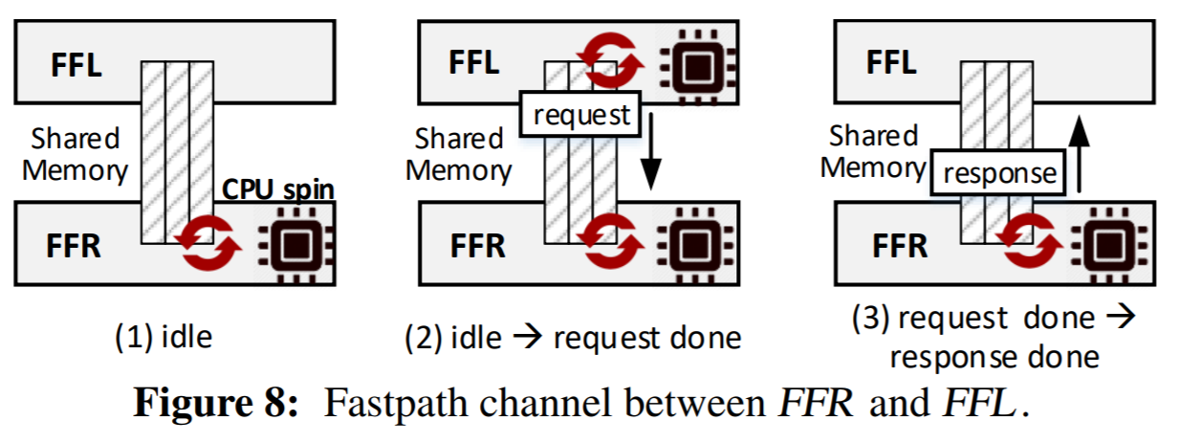
Backup
Unix socket pass through kernel, introducing several us latency
FreeFlow fastpath

Slide 32
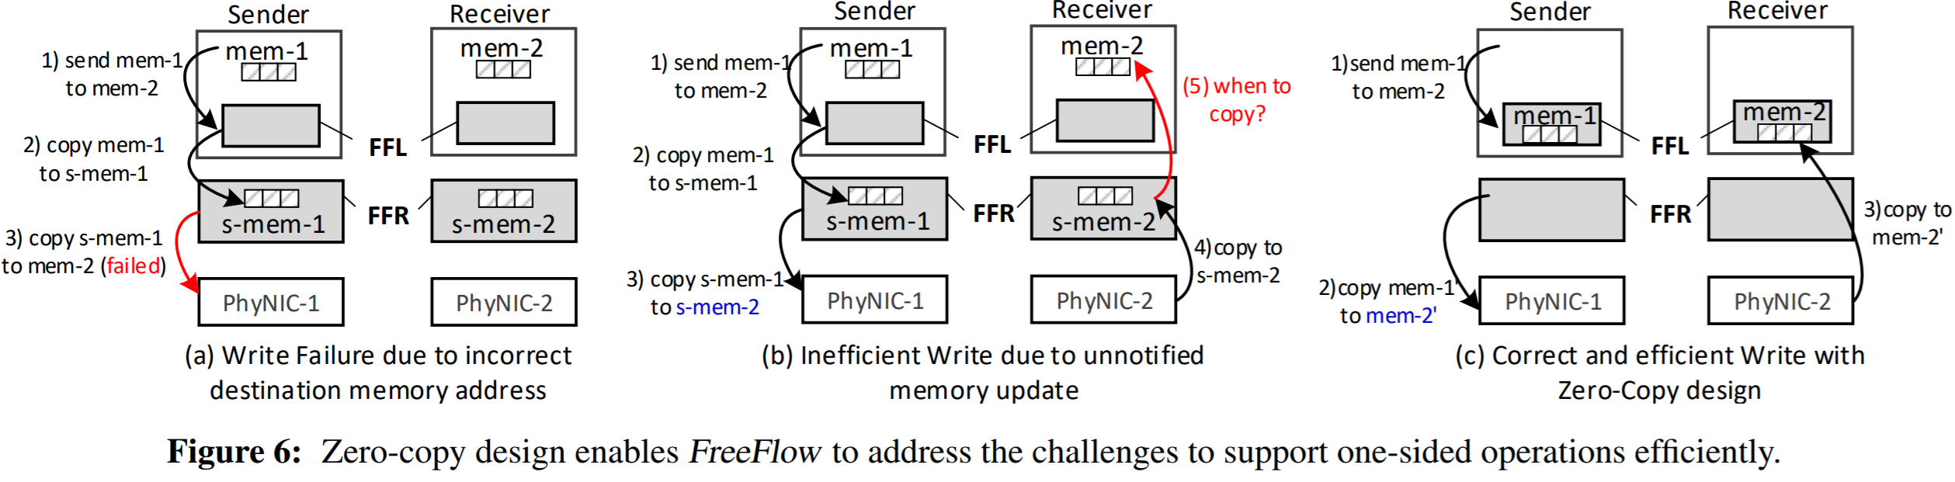
Backup
FreeFlow one-sided operations

Slide 33
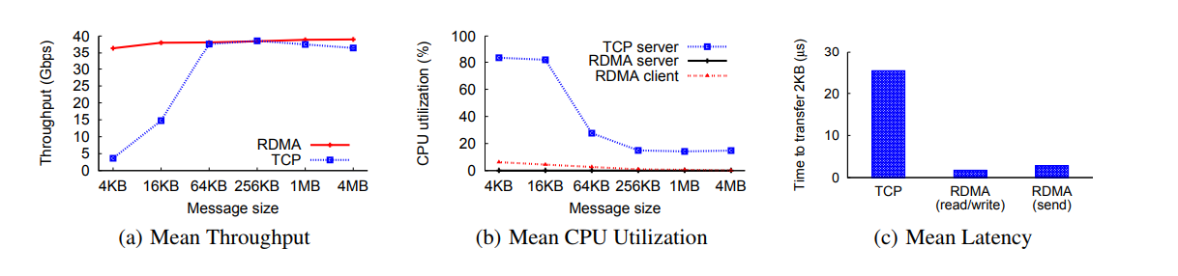
Introduction to RDMA
Zero Copy
User space
Application
Kernel
Hardware
Application
Kernel
Hardware
Driver
Driver
Why RDMA
<10us latency per hop
~92Gbps throughput
<10% CPU Utilization at 100Gbps
CPU Copy
System call
Kernel space
CPU Copy
DMA Copy
DMA Copy
Notes:
This is not the direct content of this paper, I create this page to help us have a look back on RDMA.
RDMA provides the capability to doing direct memory access(for example read and write) on remote host.
Traditional endhost networking stacks introduce high latency and substantial CPU overhead.
Comparing to traditional networking stacks, RDMA can offer ultra low latency and higher bandwidth with low CPU utilization.
Look at the three graphs below. They show the throughput, CPU utilization and latency of TCP and RDMA on a 40Gbps network.
And let’s look at the graph here. In the kernel networking stack, there are three distinct problems that slow down data transfers from or to the host;
First is context transition from userspace to kernel space and back.
Second is protocol processing time in kernel. And the third is memory copy.
By bypassing the kernel, and offloading the protocol from kernel to hardware. All of the three bottlenecks are eliminated.
That is the reason why RDMA can achieve superior performance.

